Slide 1
360camera function improvement
Summary for new function:
Based on China customer’s wants and benchmark infor, quality and UX team request us to add the following function:
ODCV: auto trigger front 360view when an object is reported to be closed to vehicle
Front/rear auto switch: when shift from reverse to drive, the view will auto change from rear view to front view.
Total cost :
We have discussed with NA ux and core team, they agree to add function above for China market, but suggest us to implement this change by IVI side, instead of the ADAS ECU. Thus these functions are APIM change only, TTL ED&T for IVI supplier YFVE is RMB 43,990
Timeline:
As discussed with IVI team, we will add these functions in DCV software, then we can verify them before PEC.

Slide 2
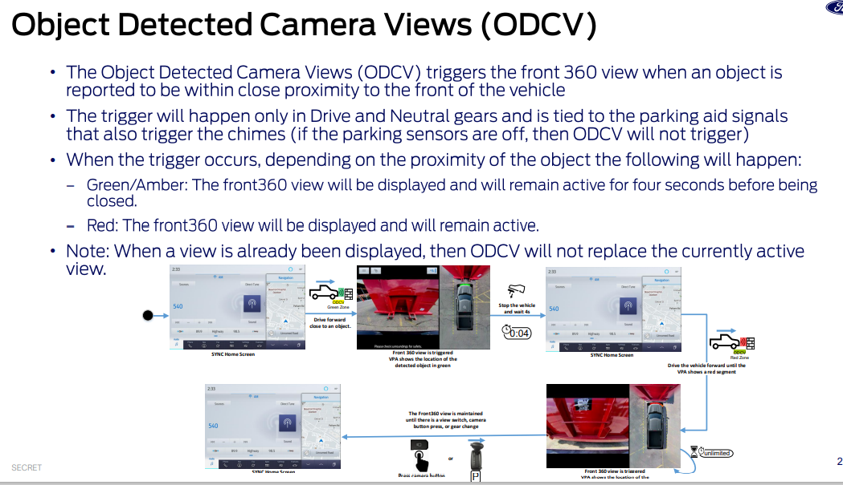
ODCV

Slide 3
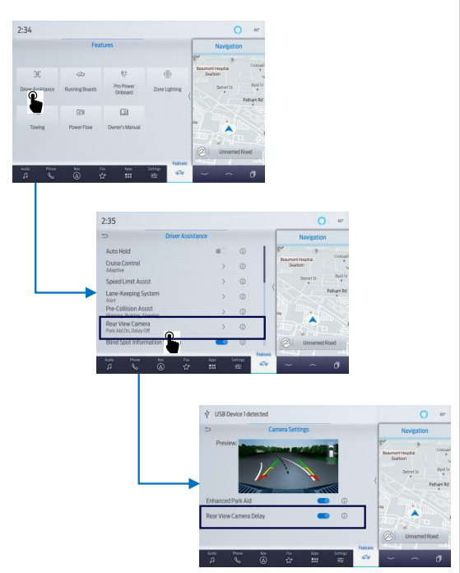
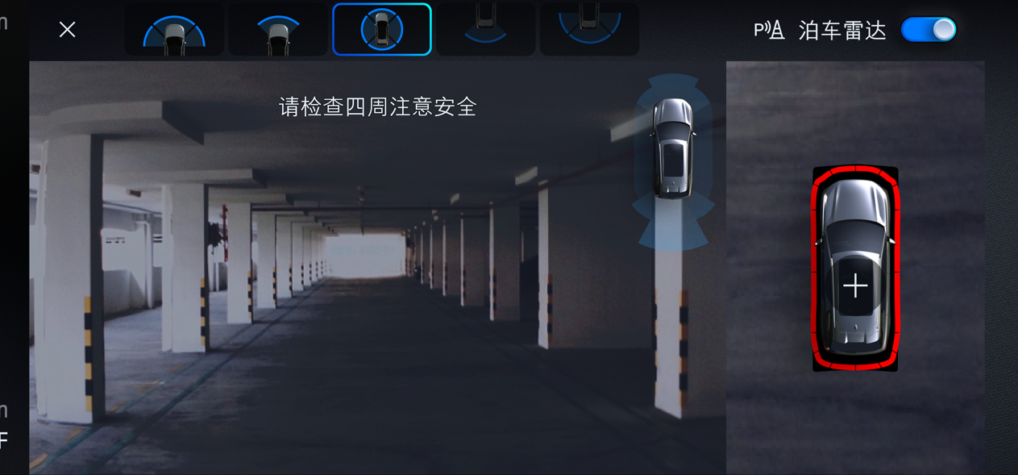
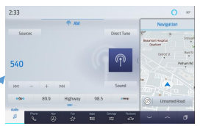

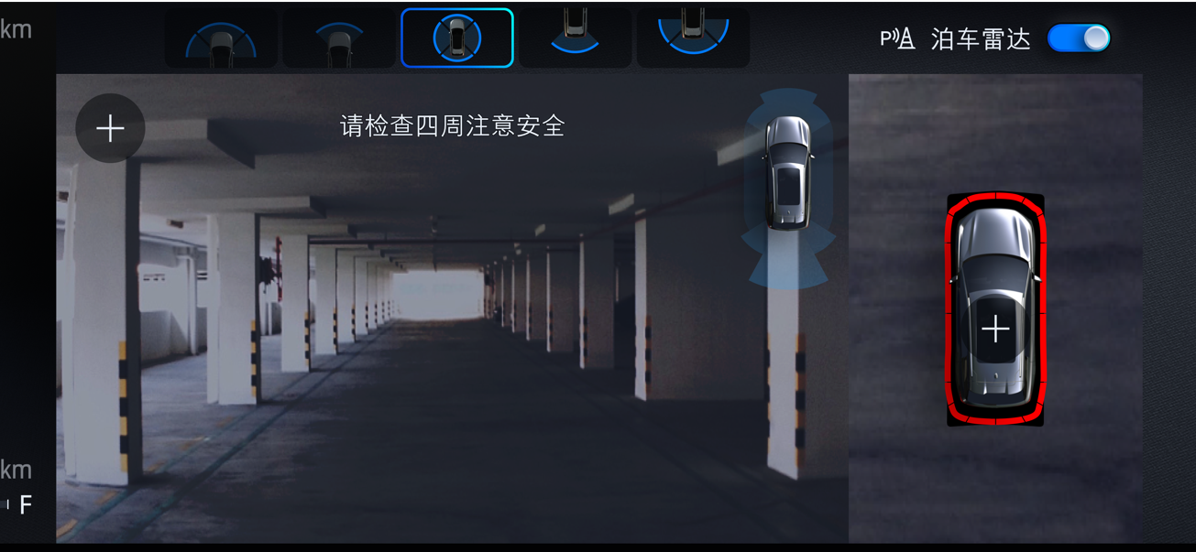

Front/Rear View Auto Switch
This function allows the user to see the front 360view after shifting from reverse to drive, up to a speed of 10kph.
This is very useful during the duration of a reversing maneuver: because in China, normally we need to proceed several rounds to park the vehicle in parking space, and after the vehicle has been placed in reverse, camera will provide the rear 360view, and when shift to drive or neutral, the front view is what customer wants when do forward motion(benchmark with BMW, BYD).
This function is conflicted with current delay on mode view. The delay mode has its own setting in SYNC+ display to enable or disable the delay after the gear shift. Cancel current rear view delay on mode function, Replace with this front 360view delay on view.
the default for delay mode set to on since UX has confirmed front 360view auto on is customer want.
Rear 360view
Delay mode on
And Speed <=10kph
Shift from R to N
Delay mode on
And Speed <=10kph
Shift from R to D,
Front 360view
X is pressed
or speed >10kph
Rear 360view
SYNC
SYNC+ home
Delay mode off
Has communicated with NA UX Team, they confirmed this function is China only request function(NA just need ODCV) and thus they will not modify the ADAS status machine, thus need IVI help to fulfill this function by adjusting its state machine.
Has communicated with NA UX Team, they confirmed this function is China only request function(NA just need ODCV) and thus they will not modify the ADAS status machine, thus need IVI help to fulfill this function by adjusting its state machine.

